Slide 1
Introduction to Nautilus
Leveraging GPU cluster for fast, standardized multi-GPU machine learning
Zhirui Dai & Zihao Zhou | University of California, San Diego

Slide 2
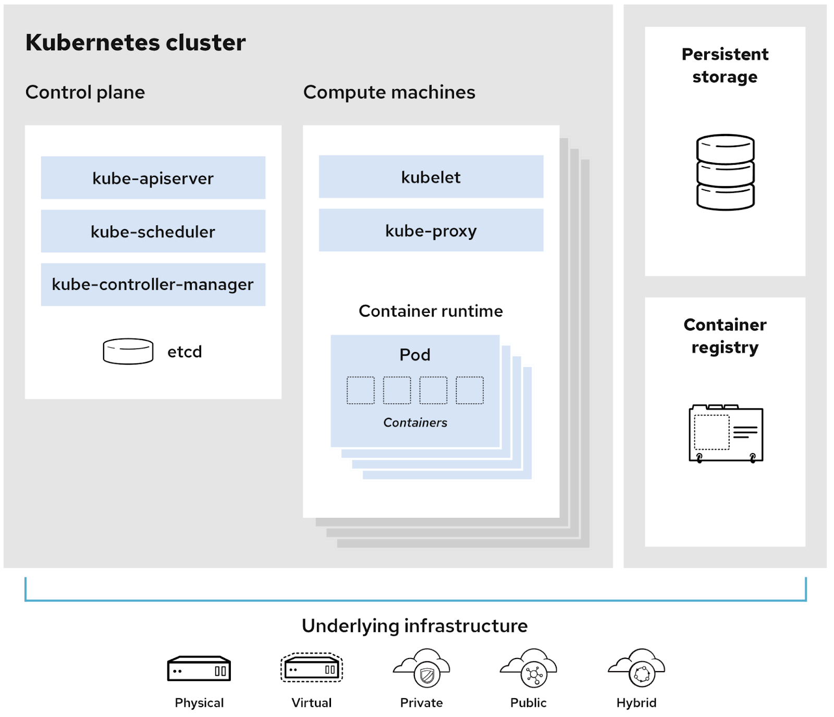
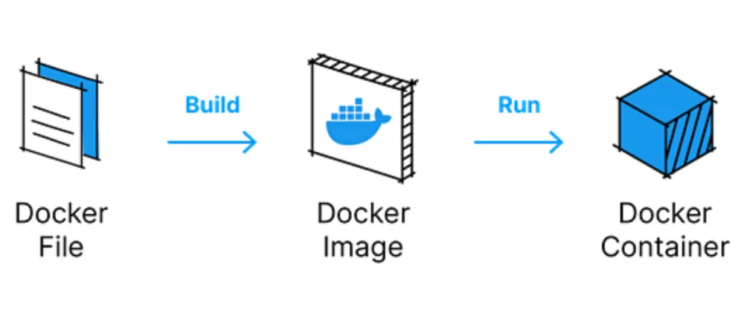
Welcome!
Before we start …
Proceed if you are —
ML researchers less familiar with ML development using Kubernetes GPU cluster and Docker containers.
What is Nautilus?
The Nautilus cluster is a cluster of mainly GPUs spread across the west coast. Given the high-speed network connectivity, where your jobs actually runs does not matter.
Why Nautilus?
Plenty of shared resources. Use idle GPU servers and data servers contributed by any universities.
Isolation. Running in an isolated pod, your machine learning tasks are free from interruptions of others’ tasks. You have ready-to-use dependencies.
Pod is a running instance (with dependencies) of your ML task.

Slide 3
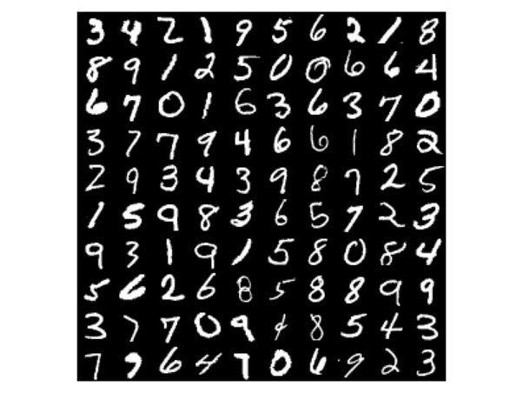
What can Nautilus do?
About Nautilus and this tutorial
Nautilus can do a lot of things:
Multi-GPU machine learning training & inference
Host Jupyter pod
Host web server
Continuous Integration (automated testing and image building after git commit)
Online doc collaboration
Online code collaboration
…
This tutorial will focus on the first two and guide you through training a convolutional model on the MNIST dataset (Hello World!) using a Nautilus pod.

Slide 4
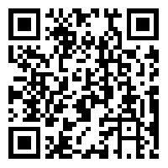
How to interact with Nautilus
Kubernetes basics and toolkits
Three mediums of running ML tasks
ML tasks can be run on Nautilus in 3 ways.
Create a pod that stays up for 6 hours. You can request at most 1 GPU. Usually for debugging.
Create a batch-job that execute a list of commands and terminates on finish. No resource limit, but requesting much more than needed or running everrunning command violates policy.
Create a deployment that stays up for 2 weeks. No resource limit, but requesting more than minimal violates policy. Usually not recommended for ML tasks.
See https://ucsd-prp.gitlab.io/userdocs/start/policies/ for more details.
Kubectl
kubectl is the official command-line tool for creating / deleting / inspecting above, and more (not covered)
GUI wrapper of Kubectl
Toolkits like Octant and VSCode Kube plugin provide GUI for kubectl.
Pros: Help understand the cluster better; Remind deletion of resource. Cons: Not so geeky.

Slide 5
Hello World!
Steps for training on MNIST using Nautilus
1. Log-in Nautilus as a student
5. Try training commands using a pod / deployment
2. Be authorized as a user under a namespace
6. Create and run your job
5.5.
Delete your deployment (required) / job / pod (recommended)
3. Claim your own/shared persistent storage
7. Monitor and set correct resource usage (required)
4. Find a good Docker image for your project
8. Retrieve your result in persistent storage
OR
Red blocks are what people usually forget to do
4. Build your Docker image and Push to Gitlab (optional)

Slide 6
Before Training MNIST

Slide 7
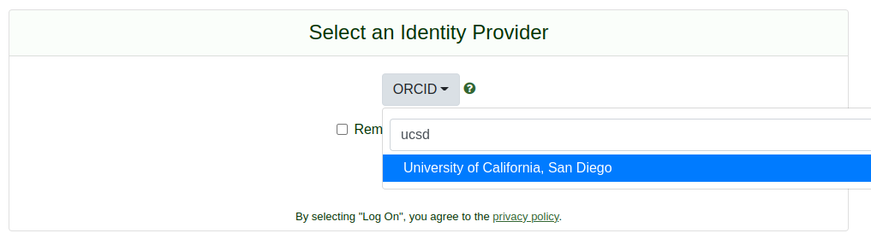
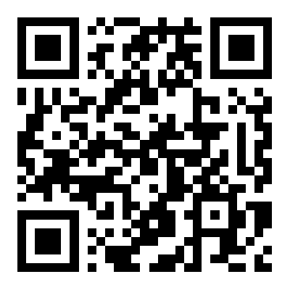
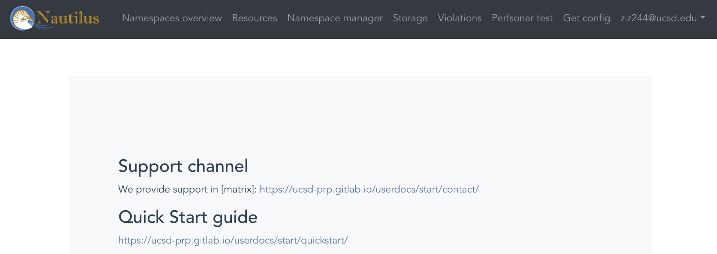
Get Approved to Nautilus
Before Running MNIST
1. Log-in Nautilus as a student; 2. Be authorized as a user under a namespace
1.1
Login into https://portal.nrp-nautilus.io
1.1 Choose the correct identity provider
1.2 Finish your login with your UCSD Active Directory account
Ask your PI to validate you as a user and add you to the lab’s namespace.
Click on the Get config link on https://portal.nrp-nautilus.io. You will then download a text file named config, which is your Nautilus credential.
1.2
1.3

Slide 8
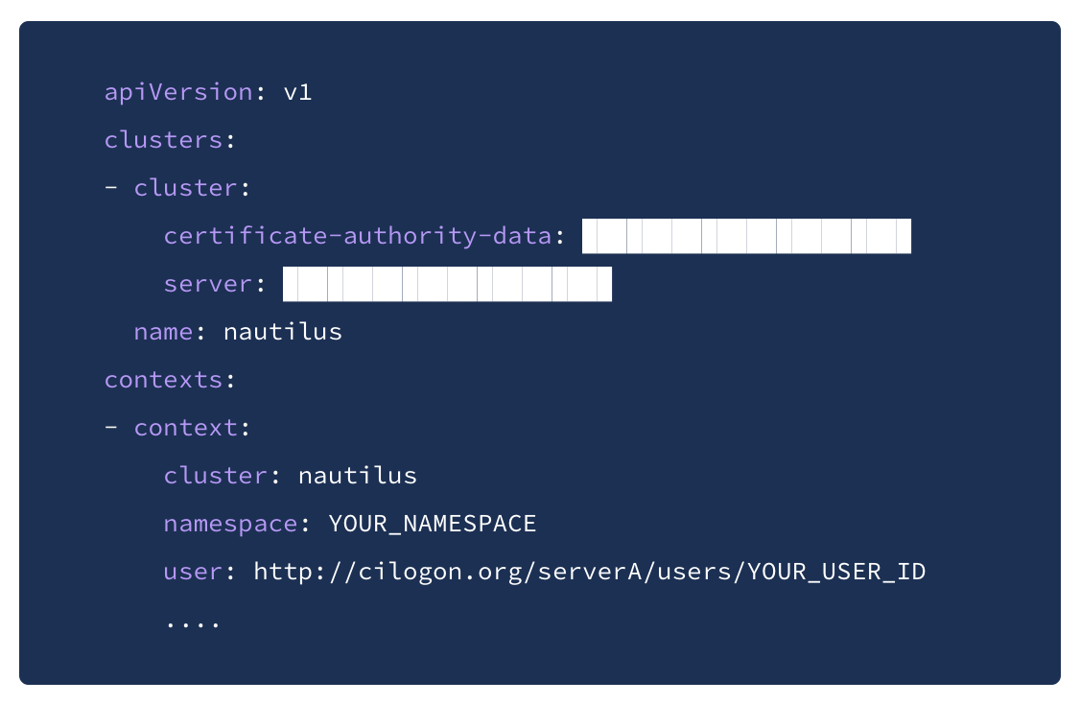
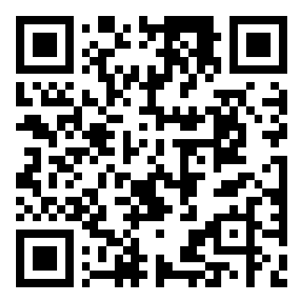
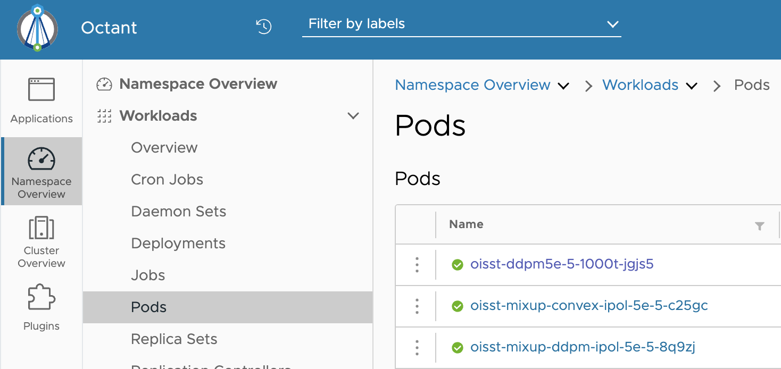
Download Toolkit
Before Running MNIST
The figure on the right shows an example config. You can find your namespace and user ID in config.
Follow the instructions below to install kubectl CLI: https://kubernetes.io/docs/tasks/tools/install-kubectl/
Copy config to your ~/.kube folder. You can create one if there is no such folder.
Try kubectl get pods for sanity check. It should print all pods under your namespace.
(optional) Follow the instructions below to install and run Octant. Octant provides a GUI for kubectl. https://github.com/vmware-tanzu/octant Go to Workloads -> Pods to see all pods.

Slide 9
Training MNIST

Slide 10
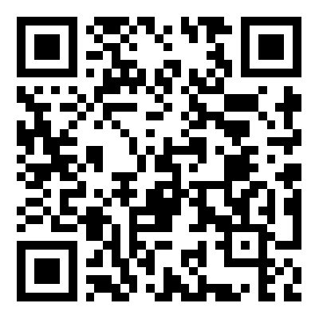
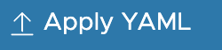
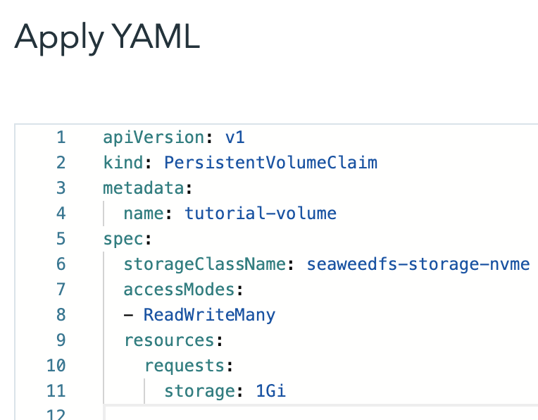
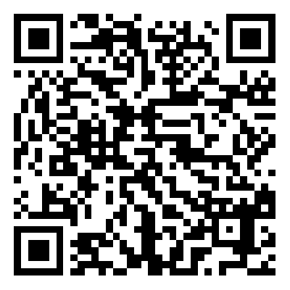
Prepare Your Environment
Training MNIST
3. Claim your own/shared persistent storage
4. If you are a CLI user, run kubectl apply -f tutorial_vol.yaml to create the volume.
If you are an Octant user, click and then copy paste the file content to create the volume.
We will use the PyTorch official MNIST example at https://github.com/pytorch/examples/tree/main/mnist.
Everything in the pod will be gone unless stored in a mounted persistent storage. After training, all results (log, models, figures) should be moved to the storage. An alternative lazy way is to directly download your files into the persistent storage.
We provide an example YAML file for request a 1GB of persistent storage. Change the (4th line) name of the storage to avoid name conflict. The file is self-explanatory. https://github.com/Rose-STL-Lab/nautilus_tutorial/blob/main/mnist/tutorial_vol.yaml

Slide 11
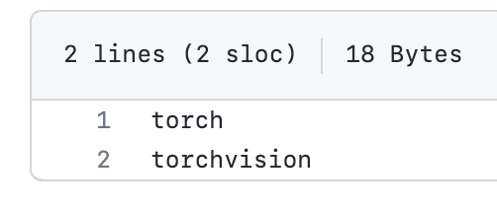
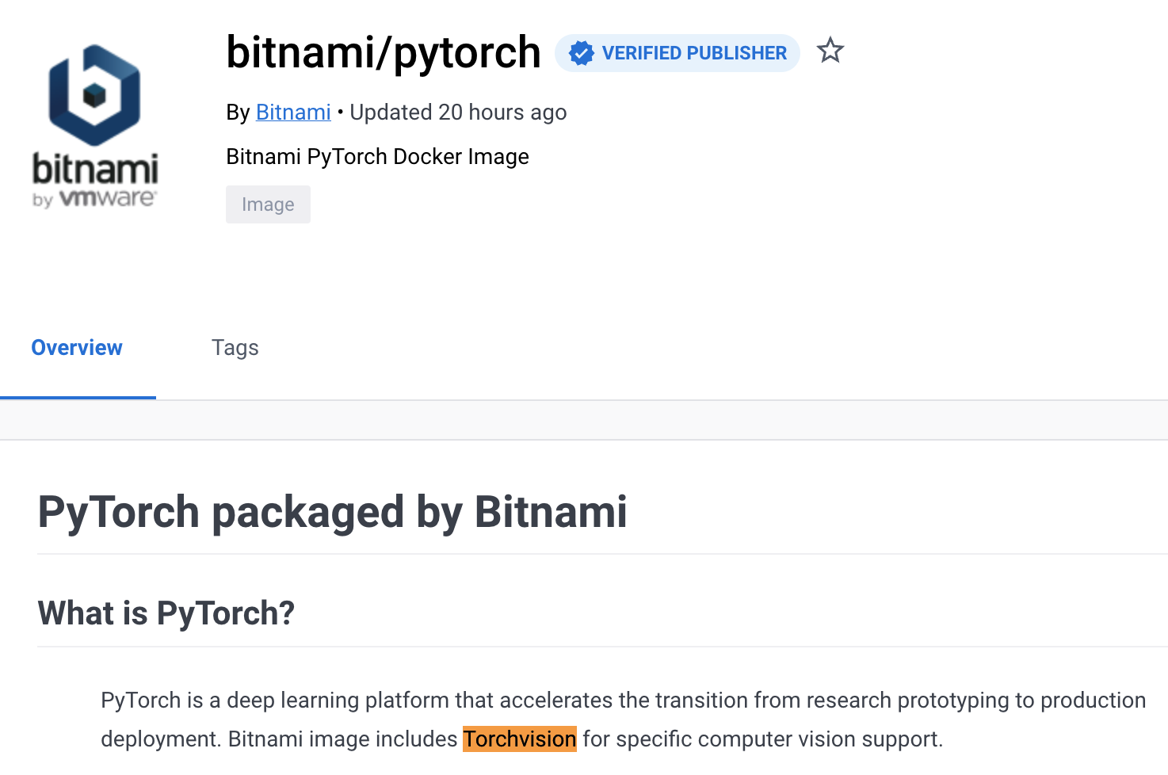
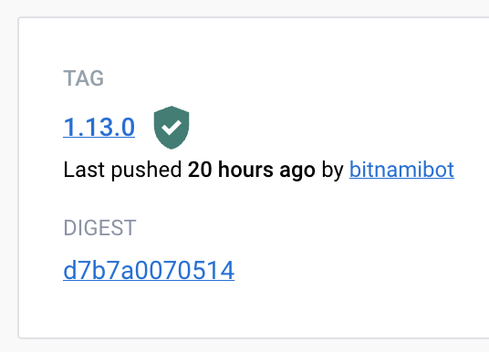
Prepare Your Environment
Training MNIST
4. Find a good Docker image for your project
Docker image is a template that defines how to install packages of software needed for the ML task.
Looking at requirement.txt, we just need two dependencies: torch and torchvision.
Dockerhub (hub.docker.com) provides many publicly available images. Searching PyTorch, we can see that a popular image bitnami/pytorch included the required torch and torchvision. Here for simplicity (as this image does not contain wget), we prepare another tutorial image for you.
Sometimes an image does not have all dependencies you needed. In this case, you can install the dependency manually in the pod, or create your own image. (skipped)

Slide 12
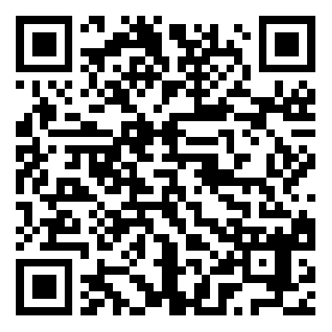
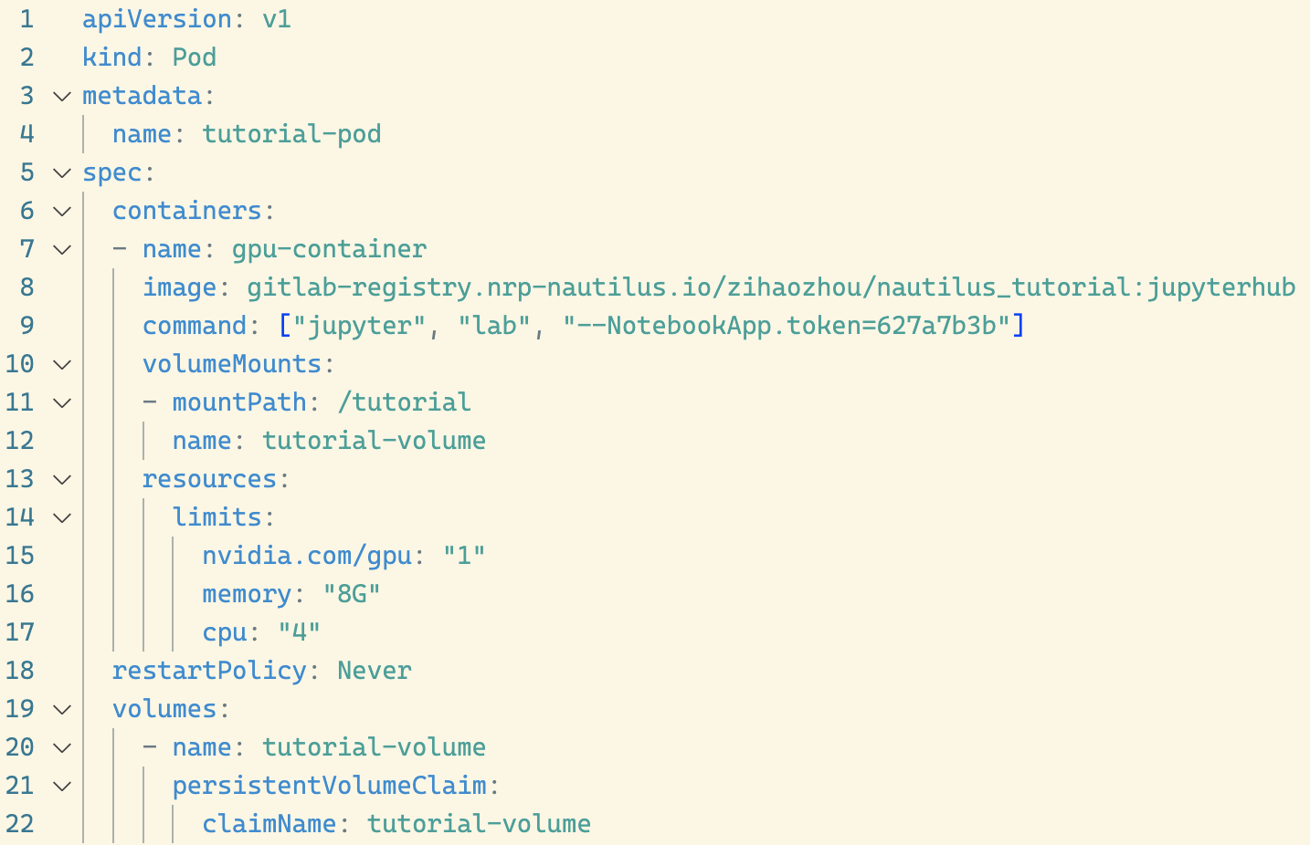
Validate Training Commands
Training MNIST
5. Try training commands using a pod
We know the commands to train MNIST and move the saved model to the persistent storage (assume it is mounted at /tutorial) are probably wget https://.../main.py; python main.py --save-model; mv mnist_cnn.pt /tutorial But we are not 100% confident.
Recall that a job executes a list of command and terminates. If you run a 20+ hours training and fail to save a model, you waste not only your time but also the shared resource.
A good practice is use an interactive pod to validate the commands. We provide an example YAML file for request an interactive pod.
https://github.com/Rose-STL-Lab/nautilus_tutorial/blob/main/mnist/tutorial-pod.yaml
Change to your pod name
Tutorial image containing pytorch, wget and jupyterlab
Request 1 GPU,
4 core CPU,
8G RAM
Run with specified token
Change to your volume name

Slide 13
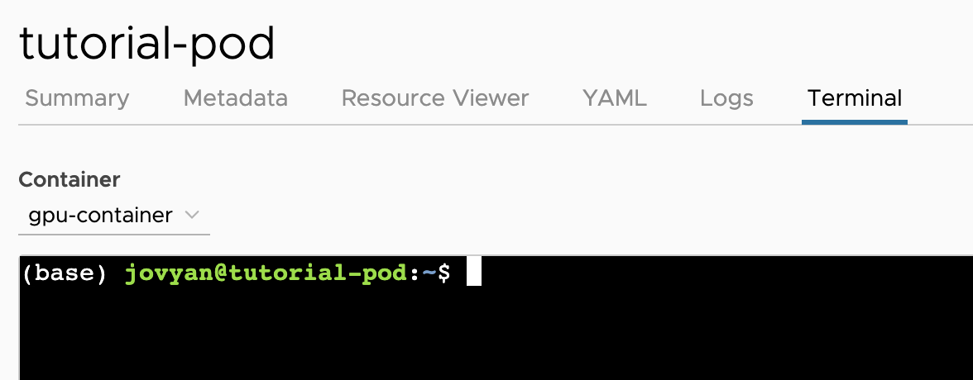
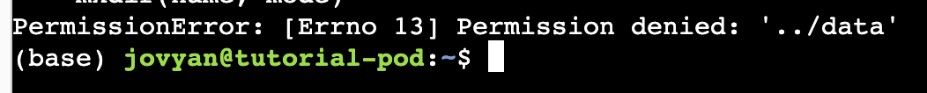
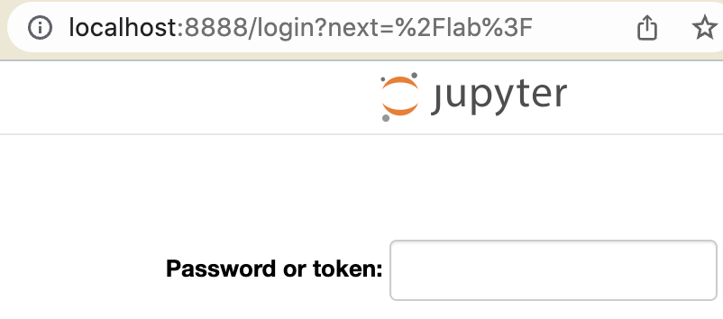
Validate Training Commands
Training MNIST
5. Try training commands using a pod
If you are a CLI user, run kubectl apply -f tutorial_pod.yaml to create the pod. If you are an Octant user, click and then copy paste the file content.
There are two ways you can debug the commands: 2.1 Terminal If you are a CLI user, run kubectl exec -it [your_pod_name] -–/bin/bash to enter the shell;
If you are an Octant user, go to Workloads -> Pods -> Terminal and there is a ready-to-use terminal.
2.2 Jupyterlab You can run kubectl port-forward tutorial-pod 8888:8888 --address "0.0.0.0" and access the pod as Jupyterlab at localhost:8888. Token is 627a7b3b (in YAML).
We can see that our commands actually have a permission problem! After mkdir, the commands work successfully.

Slide 14
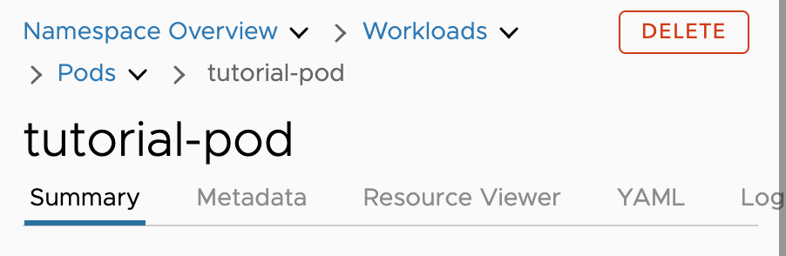
Don’t forget to delete the Pod!!!
Training MNIST
5.5. Delete your deployment (required) / job / pod (recommended)
After you finish your debugging task, your pod still occupies resources. If you were using a commercial Kube cluster, the provider will keep charging you.
Always remember to delete the pod for the greater good —
If you are a CLI user, run kubectl delete -f tutorial_pod.yaml
If you are a Octant user, simply click DELETE button

Slide 15
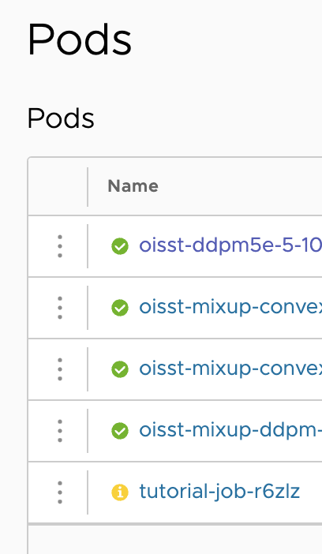
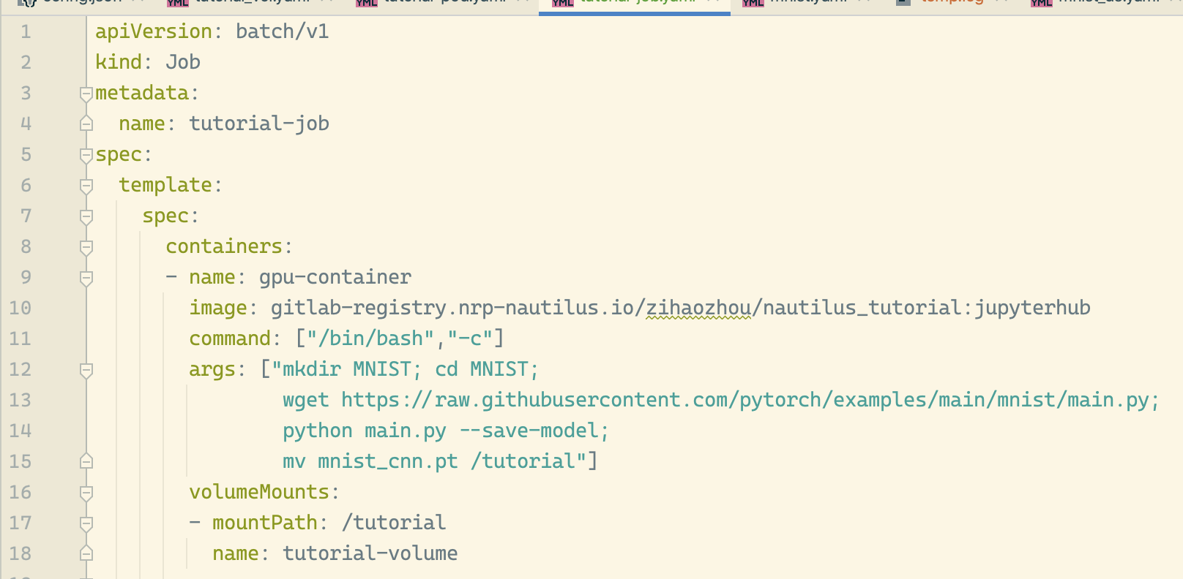
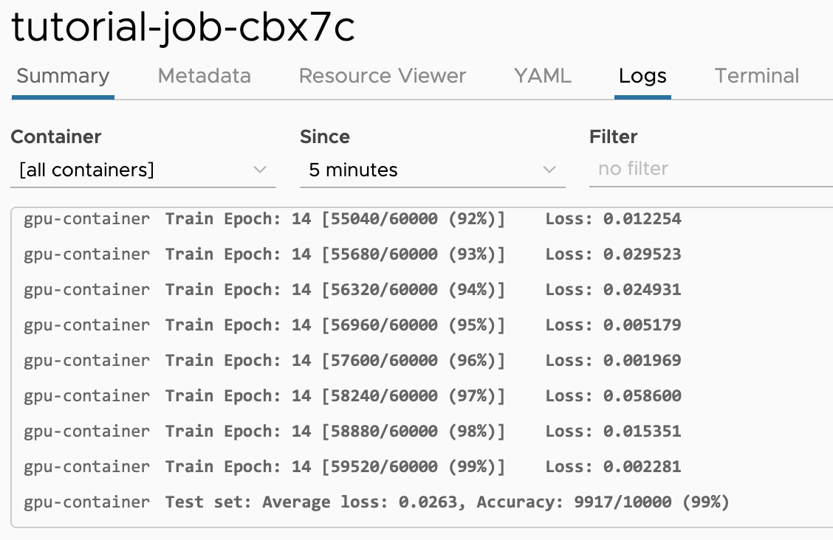
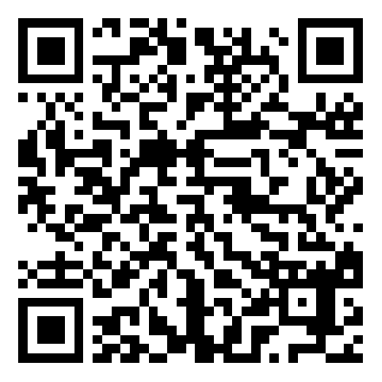
Create and Run the Job!
Training MNIST
6. Create and run your job
Now we have (1) the image (2) the validated commands and (3) persistent storage. We are ready to go!
The YAML are very similar to the pod YAML. Use kubectl apply -f tutorial_job.yaml or Octant apply to launch the job. You can see the pod generated by the job using kubectl get pods or under Octant pods list.
When the pod starts, you can run kubectl logs -f tutorial-job-[pod_postfix]to view the training log; Octant has a ready-to-use log window (see left). We trained a model with acc of 99.17%!
Remember to change this
https://github.com/Rose-STL-Lab/nautilus_tutorial/blob/main/mnist/tutorial-job.yaml

Slide 16
After Training MNIST

Slide 17
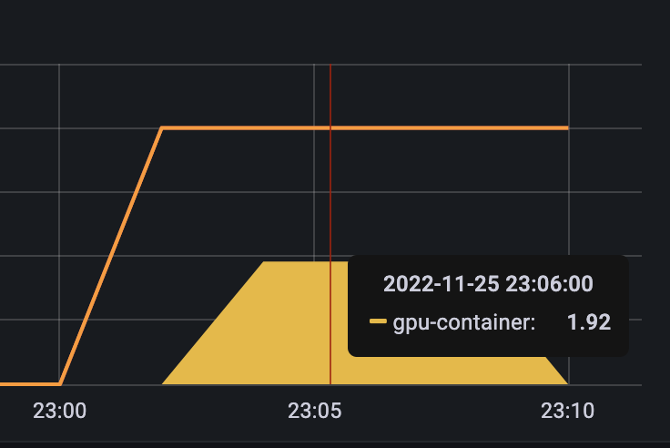
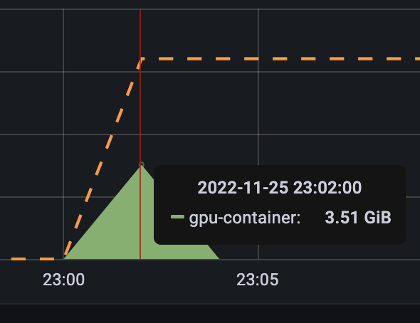
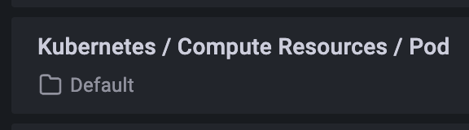
Adjust resource request
After training MNIST
7. Monitor and set correct resource usage (Required if you run more than 1 experiment)
In both pod and job, we request 4 CPU and 8GB RAM. Do we really need that much?
grafana.nrp-nautilus.io/ provides an accessible interface for monitoring your temporal pod resource usage. Visit the Kubernetes / Compute Resources / Pod dashboard and enter your namespace and pod name (tutorial_job_[postfix]).
We can see we only use at most 1.92 cores and 3.51GB RAM. So it is better to request 2 CPU and 4GB RAM for future runs.
CPU usage
RAM usage

Slide 18
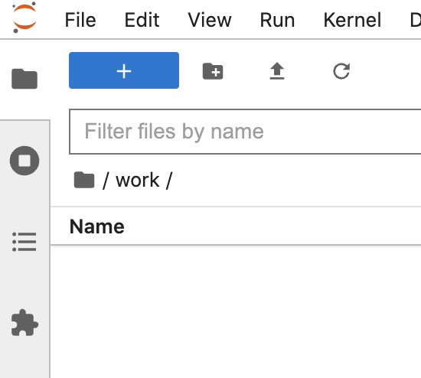

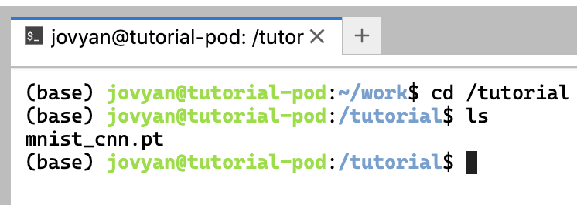
Retrieve the results
After training MNIST
8. Retrieve your result in persistent storage
Finally, we can run the interactive pod again and check the training result.
It can be seen that the work directory becomes empty (everything is gone after the pod is deleted)
However, the trained model is still kept in the path /tutorial, which is the mounted persistent storage. We can carry out further evaluation of this saved model.
……But don’t forget to delete your job and pod

Slide 19
Appendix

Slide 20
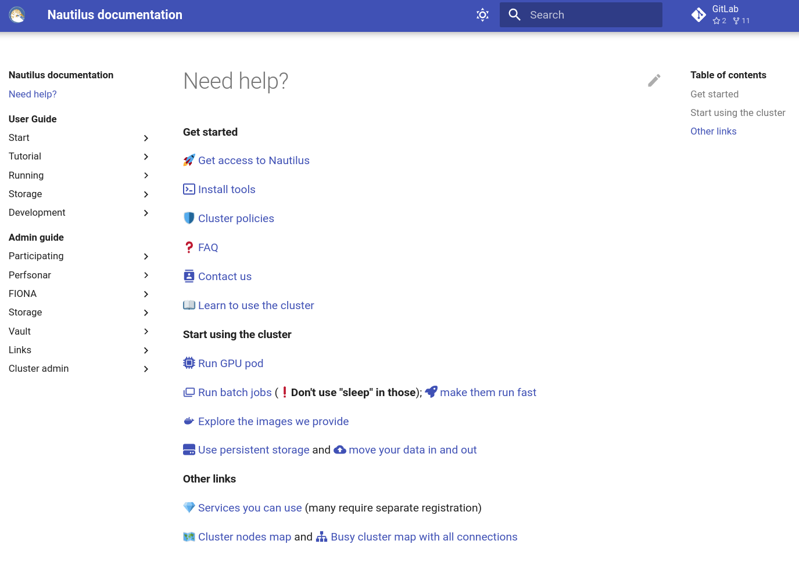
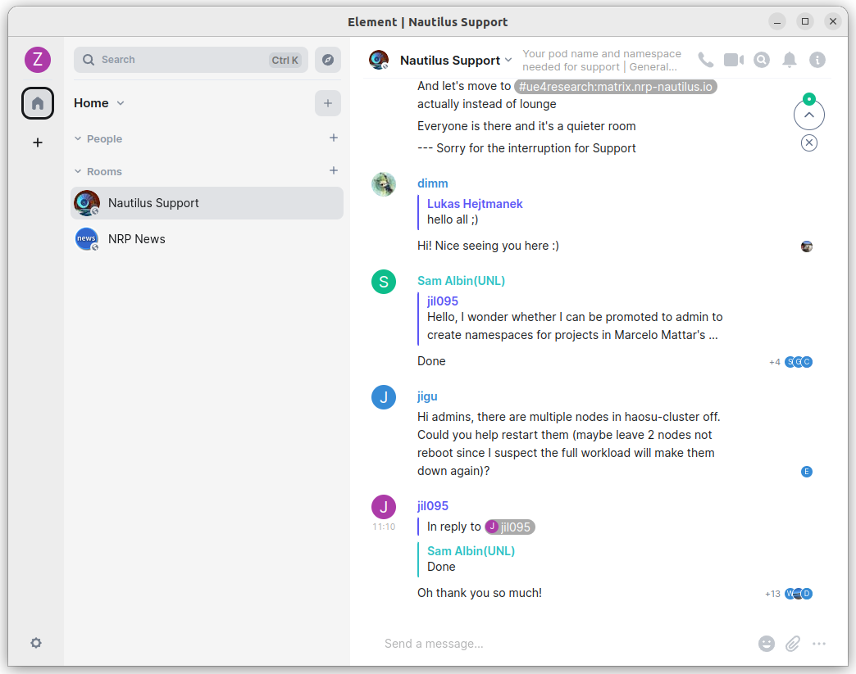
Where to get yourself supported?
1. Nautilus Documentation: https://ucsd-prp.gitlab.io/
2. Join the matrix: https://ucsd-prp.gitlab.io/userdocs/start/contact/
Submit your question here
Cluster maintenance info
Recommended for beginners

Slide 21
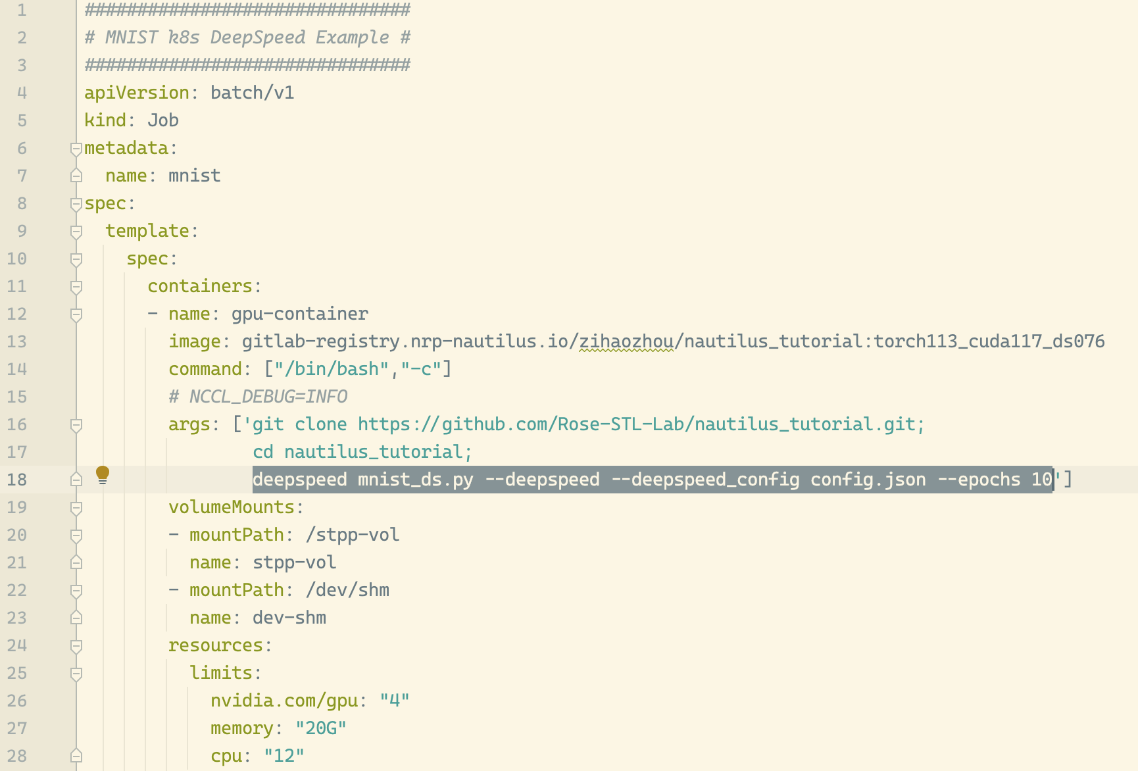
Make use of Multi-GPU
https://github.com/Rose-STL-Lab/nautilus_tutorial/tree/main/mnist gives more example YAML files for training MNIST model with distributed computing frameworks such as:
Microsoft DeepSpeed
Uber Hovorod
PyTorch Naive DDP
…
DeepSpeed accelerates MNIST
10 epochs training time to
4 RTX 3090 - 15 sec
(80 sec on 1 RTX 3090 with PyTorch)

Slide 22
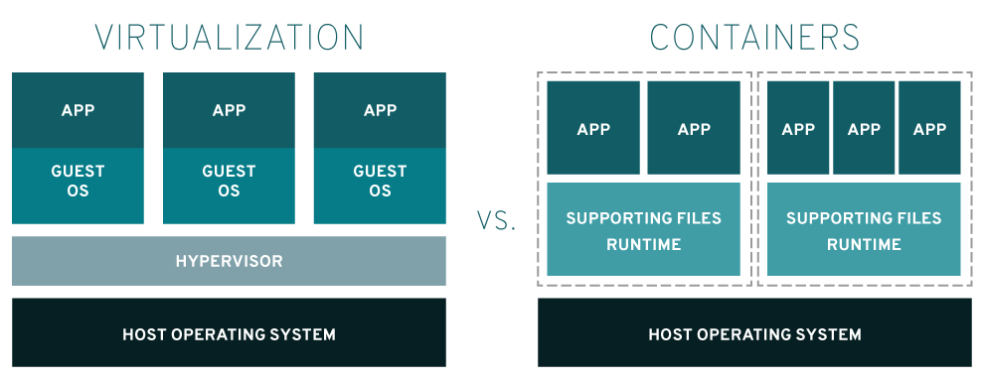
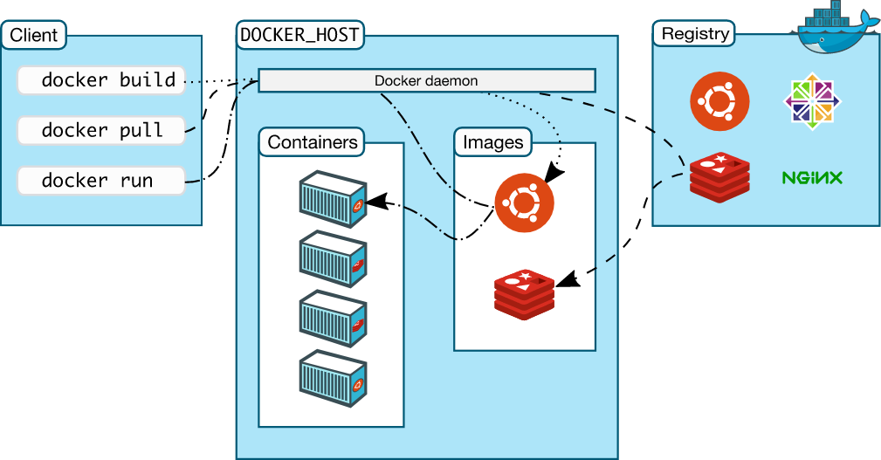
Docker: A Container Tool (Not Virtualization)
More Background …
Create different virtual envs for different applications
Install docker on your ubuntu machine:
1. GUI friendly: https://docs.docker.com/desktop/install/linux-install/
2. CLI only: https://docs.docker.com/engine/install/ubuntu/
The DockerFile (example) defines how to initialize the environment.
These images can be deployed on any machines that have the docker engine.
Nautilus docs about docker: link
For Nautilus beginners, you do not need to install and learn how to use docker.
For advanced users, we suggest you learn how to use docker to build images locally and push your custom images to the Nautilus GitLab repository.

Slide 23
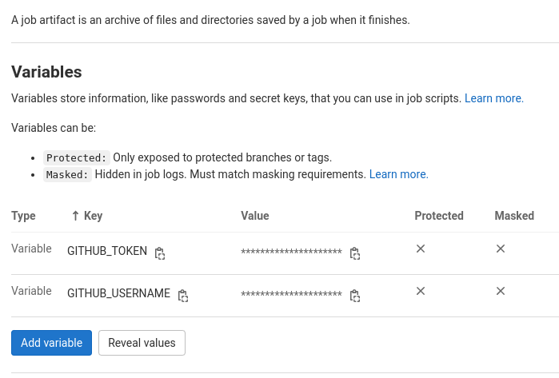
GitLab: A Version Control Tool
More Background …
With Continuous Integration, Images Delivery, etc.
Nautilus has its own GitLab service, different from the public GitLab website.
Usage 1: store your code, then you can clone your code inside the container;
Usage 2: store your custom docker images, get images provided by Nautilus
You can use GitLab CI to build your custom docker images: docs
Or you can build your images locally and push it to the container registry (RECOMMENDED):
LOGIN: docker login gitlab-registry.nrp-nautilus.io
BUILD AN IMAGE: docker build …
PUSH AN IMAGE: docker push <IMAGE_NAME>
Private repo problem:
https://ucsd-prp.gitlab.io/userdocs/development/private-repos/
https://ucsd-prp.gitlab.io/userdocs/running/jobs/#private-repo
Get access to your GitHub private repo in GitLab CI:
git clone https://$GITHUB_USERNAME:$GITHUB_TOKEN@github.com/$GITHUB_USERNAME/REPO_NAME.git

