Slide 1
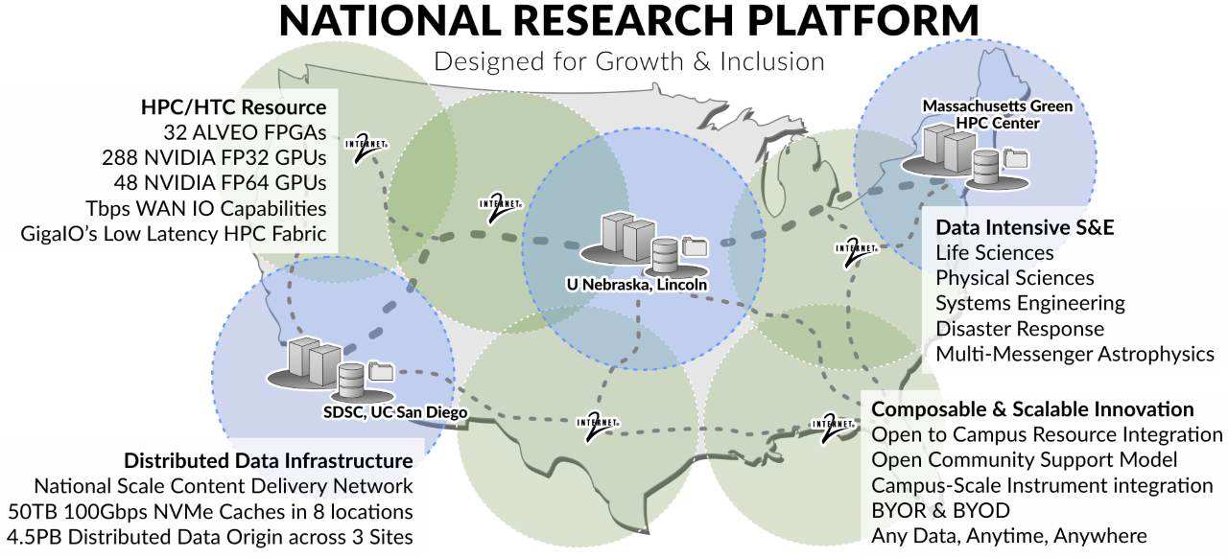

Slide 2
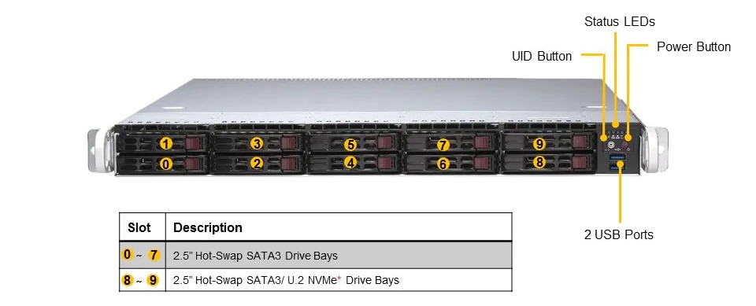
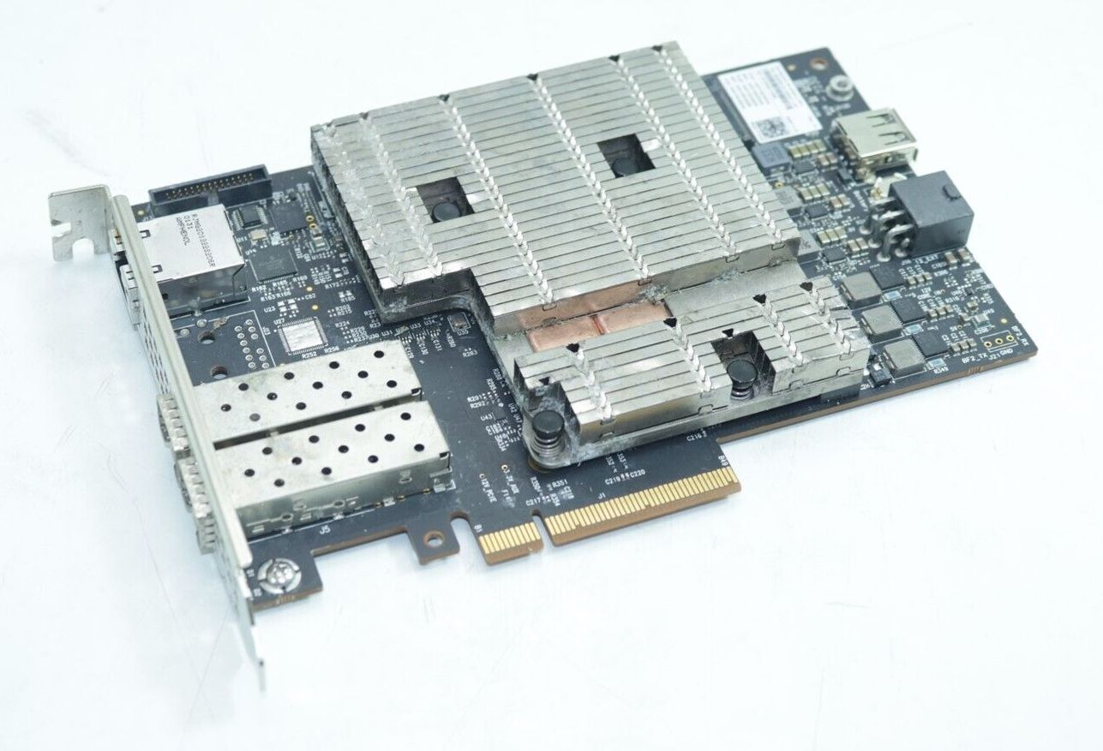
IGROK
Interactive Global Research Observatory Knowledgebase
( Bluefield 2 DPU node )
1U Single Socket AMD Rome Server
1x AMD EPYC ROME 7402P, 24-core, 2.8GHz, Processor
8x 32GB DDR4-3200 RDIMM (256GB RAM)
1x NVidia BlueField-2 SmartNIC P-Series DPU 100GbE Dual-Port
1x Samsung SSD PM1735 3.2TB PCIe MZPLJ3T2HBJR-00007
2x Samsung SSD 983 DCT 960G PCIe NVMe 2.5"
2x Samsung SSD 860 Pro 256GB 2.5" SATA III MZ-76P256E
2x SM 650W 1U -48V DC Input Power Supply (PWS-654-1R)
https://www.supermicro.com/en/Aplus/system/1U/1114/AS-1114S-WTRT.cfm

Slide 3
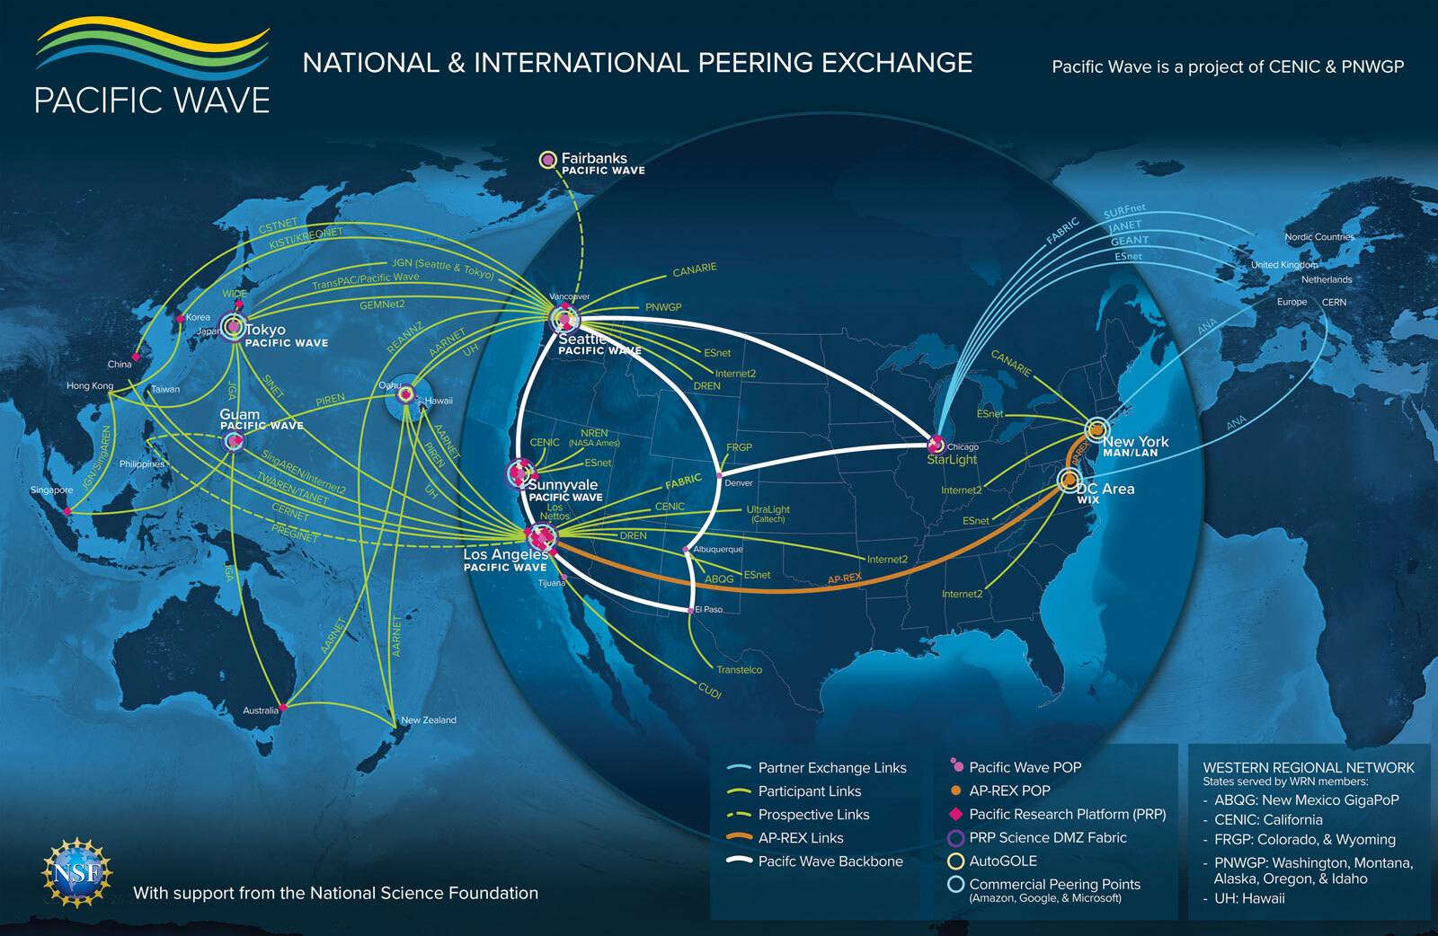





NRP Bluefield 2 - Shipping
NRP Bluefield 2 - Racked
NRP Bluefield 2 - Running

Slide 4
StarLight
2x 100G
site-rm UCSD
Atkinson Hall
1201
FABRIC
SDNAP
1x 100G
CENIC
PACWAVE
Los Angeles
S1
S2
6x 100G
2x 100G
8x 100G
OAI 5G
O-RAN Xilinx
T1-T2
MX0
400G
Oasis ½
100/400G
Prism-core
100G
1PB VAST
opennsa UCSD
Caltech
PNRP
4 nodes
32 U55C FPGAs
64x 100G
AS9516
400G
6x 100G
SN3700
200G
SDSC (Q47)
West Datacenter
PNRP
8 node
64 DGX A100
8x 100G
8x 100G
controller1
Fungible
opennsa PNRP
k8s-bf2-01
PNRP
6 CPU nodes
6x 100G
Ampere Altra 80 core ARM
site-rm SDSC
SDSC [I-J-K]47
k8s-gen4-01
Juniper 10G
PNRP / Nautilus
PRISM / Nautilus dev-cluster
k8s-gen4-02
S1
…
S8
3x 200G 2x 100G
Notes:
PNRP Acceptance Test

Slide 5
StarLight
3x 400G
site-rm UCSD
Atkinson Hall
1201
FABRIC
SDNAP
3x 400G
CENIC
PACWAVE
Los Angeles
S1
S2
4x 400G
4x 400G
8x 100G
OAI 5G
O-RAN Xilinx
T1-T2
MX0
400G
Oasis ½
400G
Prism-core
100G
1PB VAST
opennsa UCSD
Caltech
PNRP
4 nodes
32 U55C FPGAs
64x 100G
AS9516
400G
6x 200G
7x 100G
SDSC (Q47)
West Datacenter
SN3700
200G
PNRP
8 node
64 DGX A100
8x 100G
8x 100G
controller1
Fungible
IGROK-1
opennsa PNRP
IGROK-2
k8s-bf2-01
PNRP
6 CPU nodes
6x 100G
Ampere Altra 80 core ARM
site-rm SDSC
IGROK-3
IGROK-4
SDSC [I-J-K]47
k8s-gen4-01
Juniper 10G
IGROK-5
PNRP / Nautilus
PRISM / Nautilus dev-cluster
IGROK-6
k8s-gen4-02
S1
…
S8
IGROK-7
5x 200G
Notes:
PNRP Phase I

Slide 6
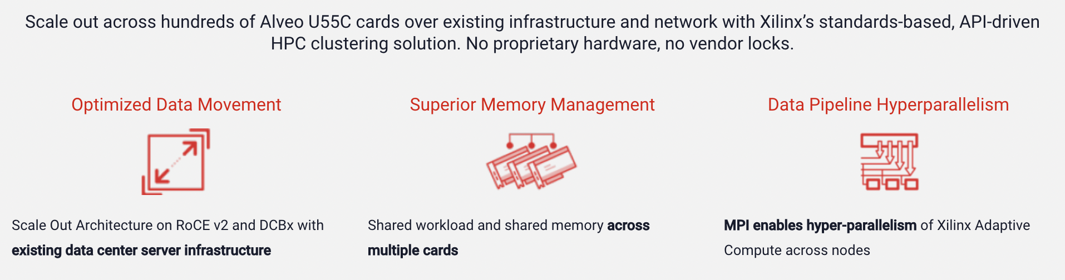
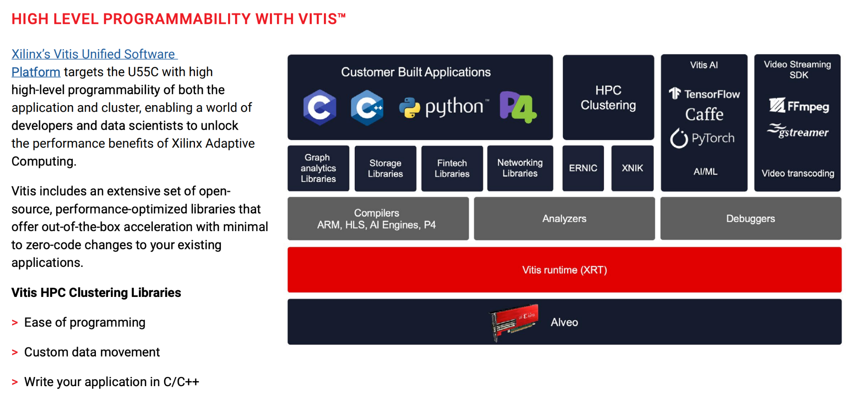
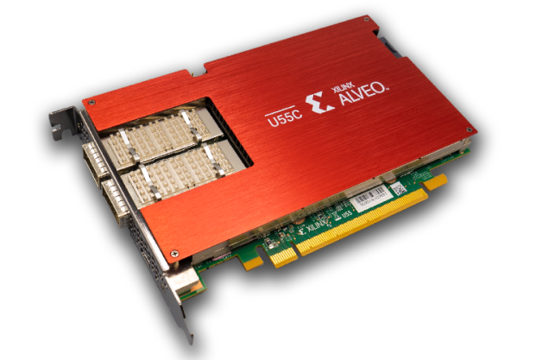
Notes:
32 of these Xilinx U55C FPGAs are installed in GigaIO FabreX Accelerator chassis.
They can be composed with CPU nodes or 8 HGX A100 80G GPU nodes ( 64 A100s )

Slide 7

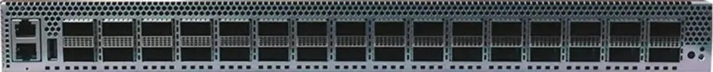
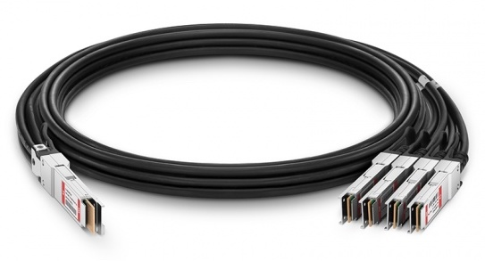

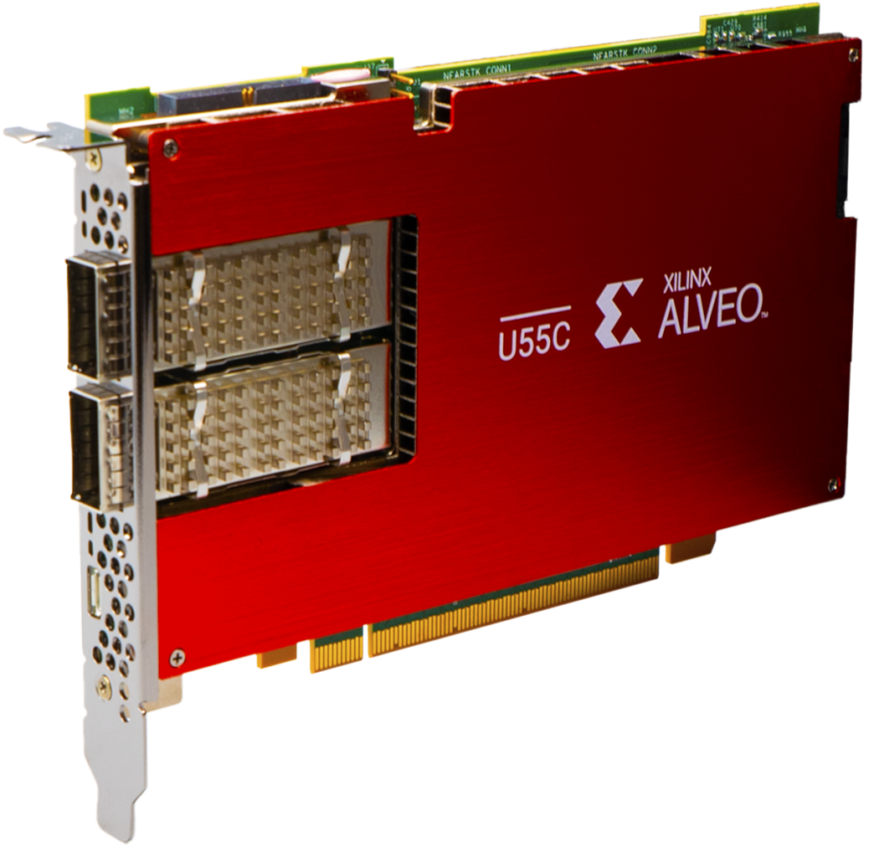





FPGA Applications run on single 100G links or as a “bump in the wire” using 2x 100G links for stream processing.
DCS810 DATA CENTER SWITCH
25.6T Tofino 2
16x 3m (10ft) 400G QSFP-DD to 4x100G QSFP56 Passive Direct Attach Copper Breakout Cable
32x Xilinx U55C FPGAs
GigaIO Composable FabreX switches connect the CPU, GPUs, NVMes and FPGAs
AutoGOLE/SENSE composes the L2/L3 network paths.
GigaIO FabreX PCIe Gen 4 switches
Notes:
The NRP Cat II award

Slide 8
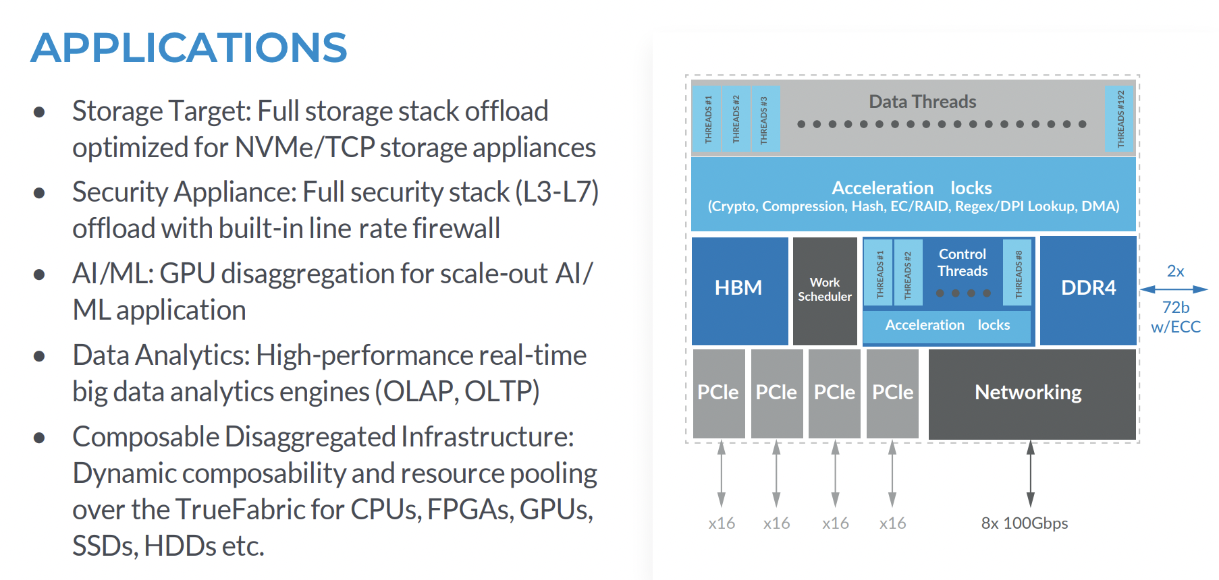
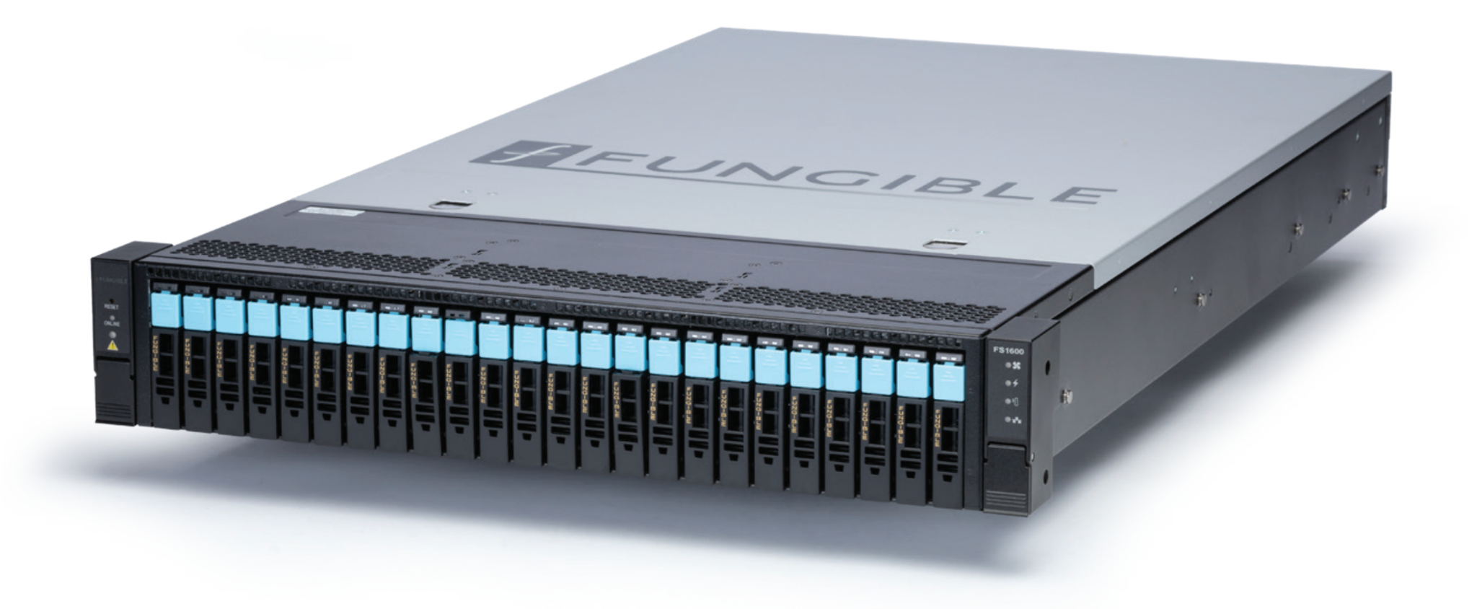

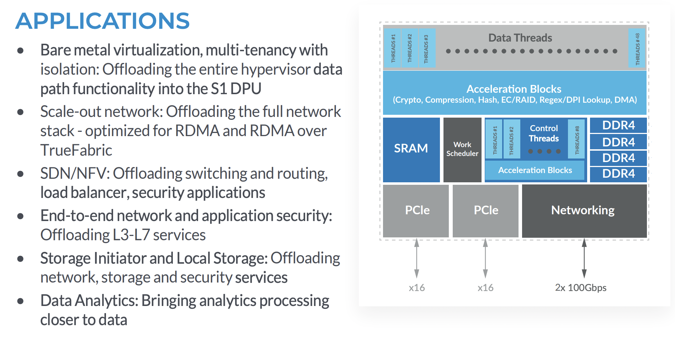
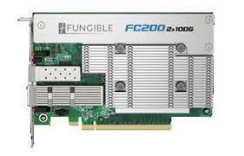
Notes:
We are experimenting with the Fungible system using the FC200s for NVMe/TrueFabric and hope to restart experiments using the FS1600’s two F1 DPUs for a computational storage platform.

Slide 9

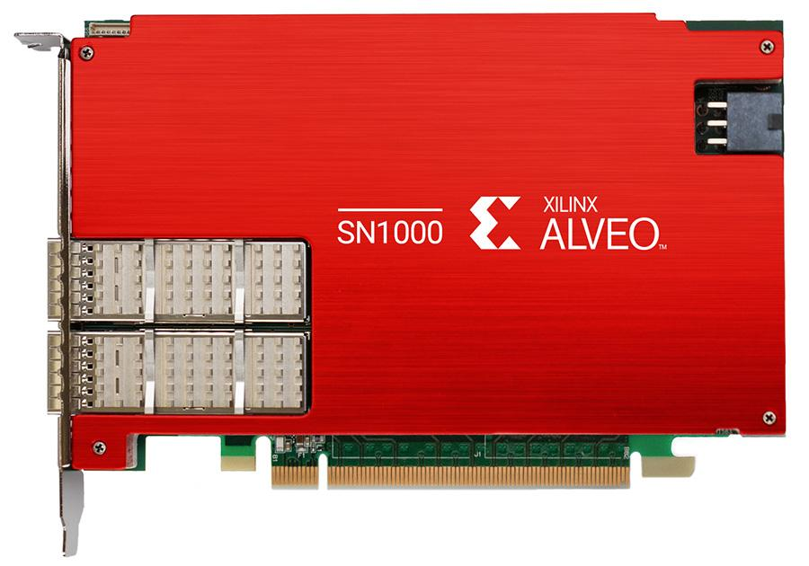
General Networking
TCP/UDP Checksum Offload (CSO), TCP Segmentation Offload (TSO), Generic Send Offload (GSO)
Generic Receive Offload (GRO), Receive Side Scaling (RSS)
VLAN Insertion/Removal
VLAN Q-in-Q Insertion/Stripping
Jumbo Frames (up to 9KB)
Traffic Steering
TCP/UDP/IP, MAC, VLAN, RSS filtering Accelerated Receive Flow Steering (ARFS), Transmit Packet Steering (XPS)
Network Acceleration
Onload®/ TCPDirect - TCP/UDP
Open Virtual Switch (OVS)
DPDK Poll Mode Driver
Hardware Offloaded Virtio-net
  Virtio v0.9.5 and later
  CSO, TSO
  Multi-queue
  vDPA (Virtual Data Path Acceleration)
Software and FPGA Extensibility
Support for custom plug-ins to enable new functionality; programmed via P4, HLS, or RTL.
Hardware-based Packet Processing
Wildcard match-action flow tables
Tunnel encap/decap – VXLAN, NVGRE
Connection Tracking
Packet Replication
Header rewrite/NAT
Per-rule packet and byte counters
MAC Address rewriting
4 M stateful connections and up to 20K Megaflows with wildcard match support
Storage Acceleration
Ceph RBD Client Offload
Hardware Offloaded Virtio-net
  Virtio v0.9.5 and later
  Multi-queue
Notes:
UCSD and SDSC have Xilinx SN1000 SmartNICs deployed.
SDSU has active security research with NPS.

Slide 10
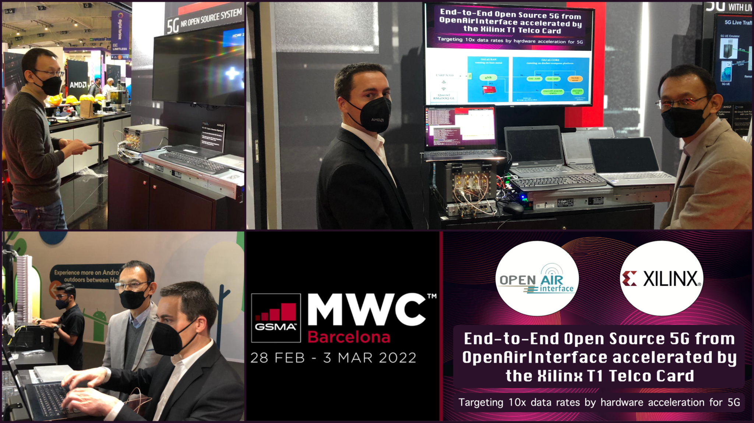
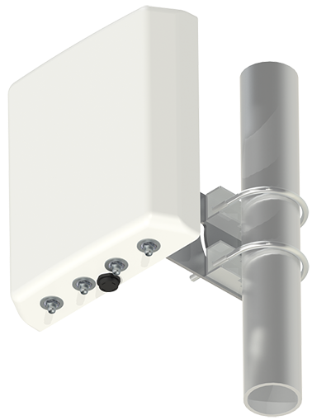
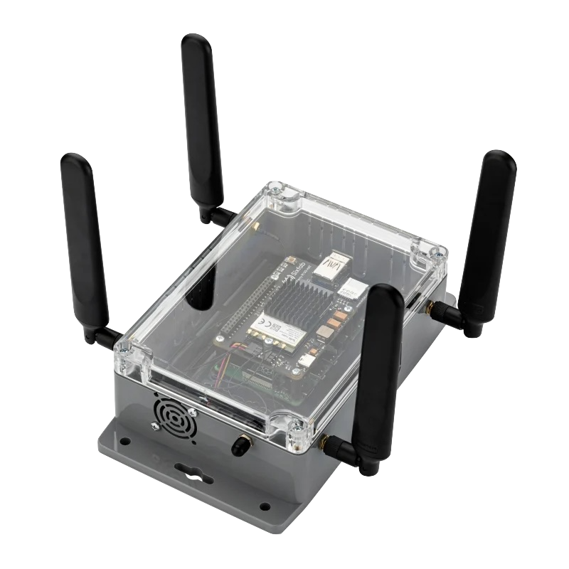
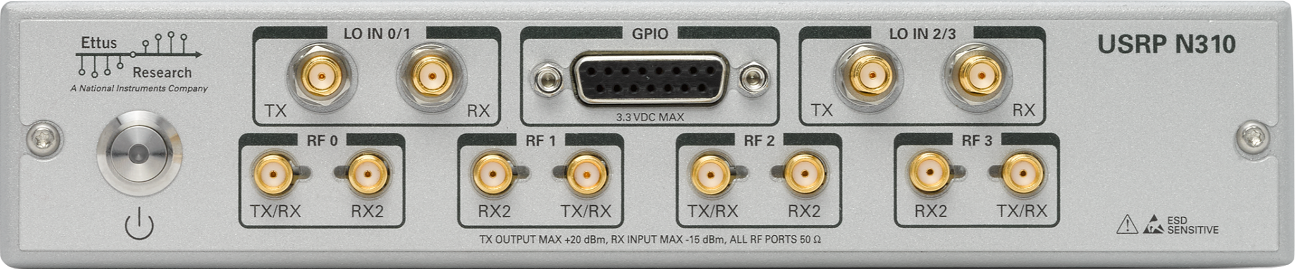
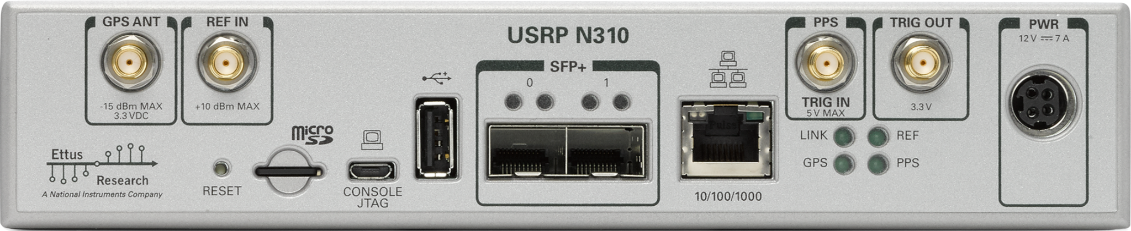
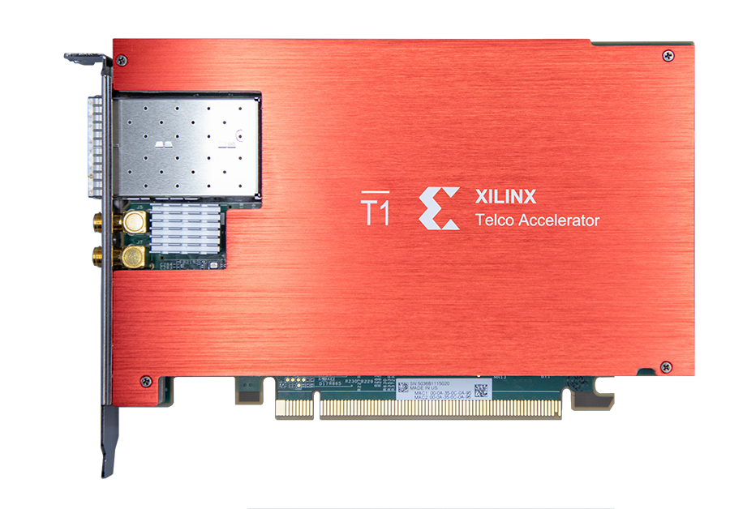
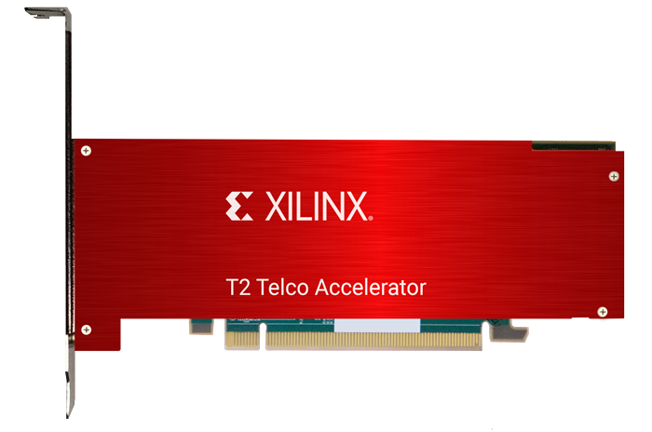
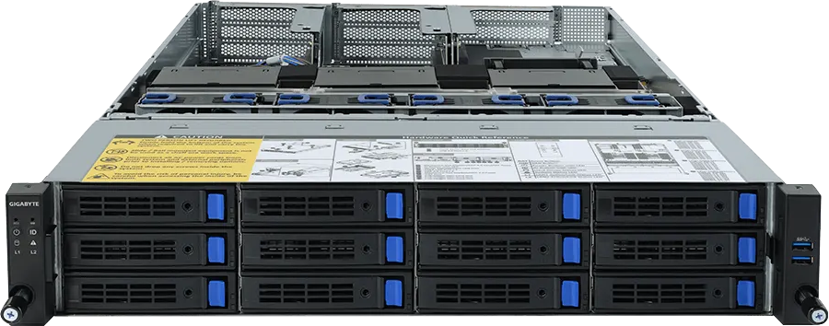

Access and Mobility Management Function (AMF)
Session Management Function (SMF)
User Plane Function (UPF)
External Data Network (EXT-DN)
OAI 5G CORE
Kubernetes Helm
OAI-AMF
N2
Namf
MySQL
N2
Nsmf
OAI-SMF
gNB
gNB
N3
N4
N3
OAI 5G RAN
gNB | Next Generation NodeB
OAI-UPF
OAI 5G RAN
gNB | Next Generation NodeB
OAI-EXT-DN
AutoGOLE
SENSE
5G Fronthaul
5G Fronthaul
5G IoT sensor
5G IoT sensor
L1 Offloading
L1 Offloading
Notes:
The gNB (Next Generation NodeB) provides 5G NR User Plane and Control Plane terminations towards UE (User Equipment).
The gNB houses three functional modules viz. CU (Control Unit), DU (Distributed Unit) and Radio Unit (RU).
The External Data Network (EXT-DN) is the AutoGOLE/SENSE network layer for wide area path automation

Slide 11
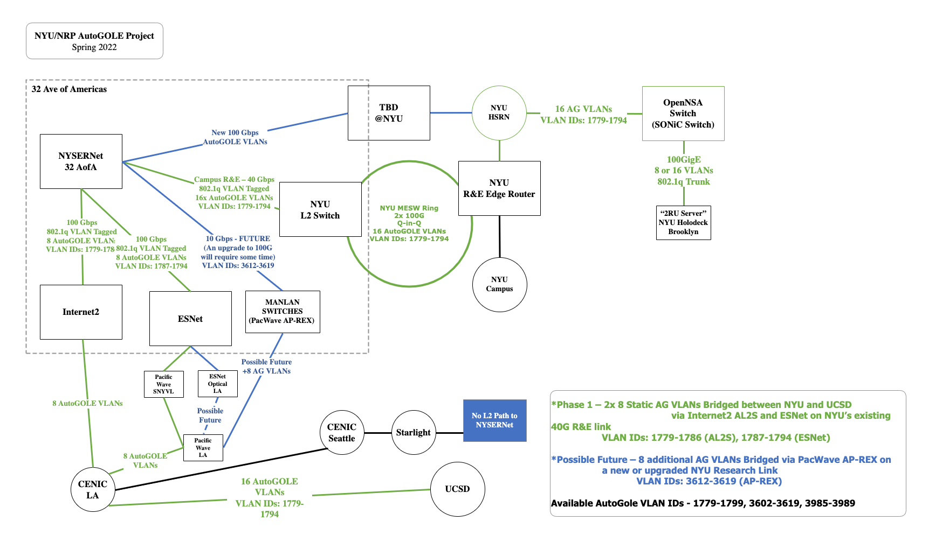




Planning L2 paths:
UCSD to NYU for AutoGOLE/SENSE/OpenNSA
5G end to end O-RAN testbed
AmLight
AMPATH
Notes:
These are the paths and VLANS we engineered for linking NYU to UCSD in the 5G O-RAN testbed.
The dashed green line is the active path we are currently testing.

Slide 12
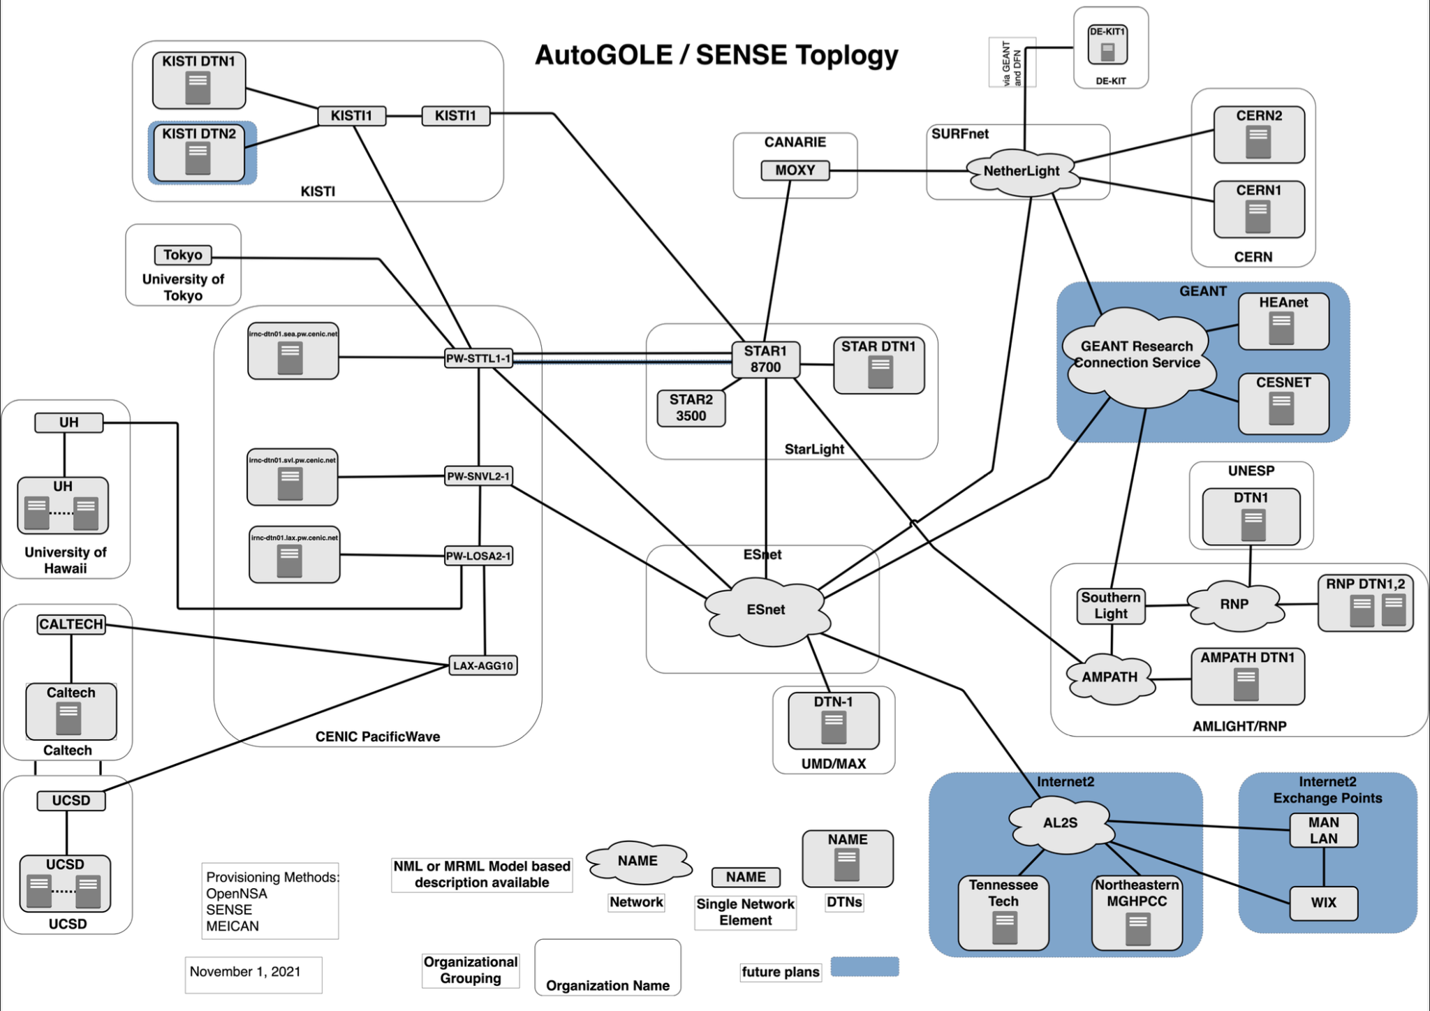
https://www.es.net/network-r-and-d/sense/
Notes:
This is a recent map of the SENSE/AutoGOLE/OpenNSA testbed we have built.

Slide 13














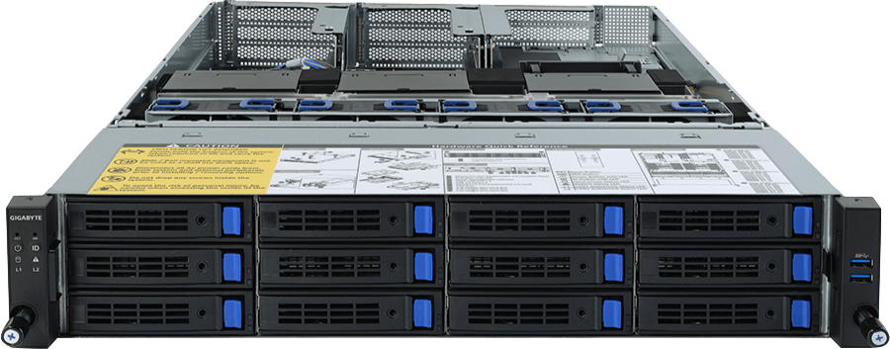
Services
PerfSONAR
SFlow
inMon TS
ElastiFlow
PerfSONAR
SFlow
inMon TS
ElastiFlow
PerfSONAR
SFlow
OpenAlto G2
OpenAlto G2
inMon TS
ElastiFlow
OpenAlto G2
APIs
Ansible
NetBox
SENSE-NRM
OpenNSA
Ansible
NetBox
SENSE-NRM
OpenNSA
Ansible
NetBox
Admiralty
Admiralty
SENSE-NRM
OpenNSA
Admiralty
NAPALM
Automation
Routers
Switches
Smart NICS
Notes:
NSI Federation

Slide 14
UCSD
Caltech
ICAR
ASTRONOMY
namespace
LHC
namespace
Ansible
NetBox
SENSE-XM
OpenNSA
Ansible
NetBox
SENSE-XM
OpenNSA
Ansible
NetBox
Admiralty
Admiralty
SENSE-XM
OpenNSA
Admiralty
Notes:
Multiple Science domains can use federated namespaces to simultaneously share resources housed in multiple clusters with their own distributed storage pools.
We are still working on the federation of storage. The Mellanox BlueField 2 DPU is one of the new technologies we will explore to accelerate federated storage nodes. We will also run the RARE Freerouter distropution on the Bluefiled 2 DPU and participate in the international P4 testbed.

